Slide 1
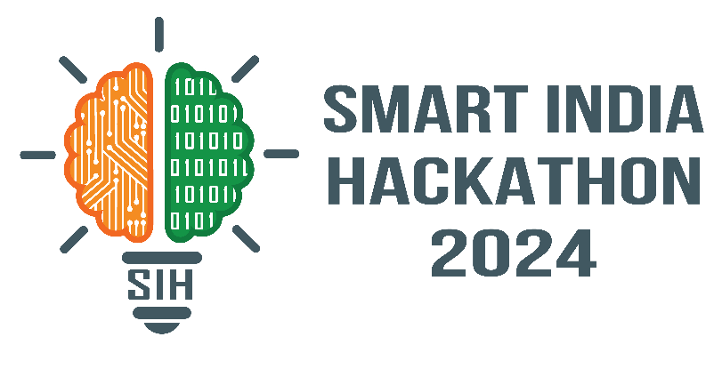

SMART INDIA HACKATHON 2024
Problem Statement ID – 1582
Problem Statement Title- System to check the healthiness of earthing system and alert staff in case of any malfunction.
Theme- Miscellaneous
PS Category- Hardware
Team ID-
Team Name - FLUX

Slide 2
IDEA
FLUX
Proposed Solution
Explanation of the proposed solution
Our earthing health monitoring solution designs a device and a software which provides comprehensive oversight through three key functionalities:
1)Real-time Earthing Voltage Monitoring: Continuously measures voltage levels to ensure optimal earthing performance.
2)Earth Leakage Current Tracking: Detects and monitors abnormal leakage currents to identify potential hazards.
3) Fault Prediction: Utilizes advanced algorithms to anticipate potential earthing failures, enabling proactive maintenance.
Innovation and uniqueness of the solution We have designed a device to check and maintain healthiness of earthing system.
The device has following functions:
Fault Prediction Model
Compact Device
Automation
Cost-effective
Real time Access
Centralized platform
User-friendly software

Slide 3
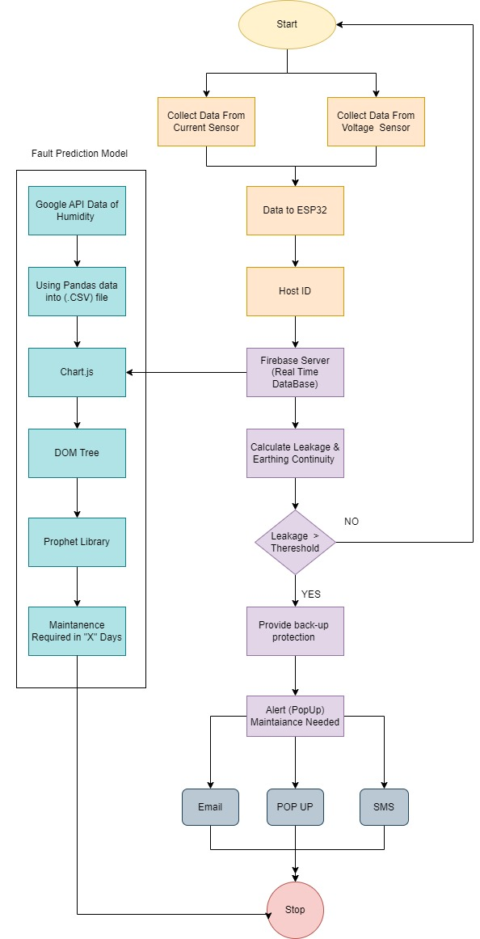













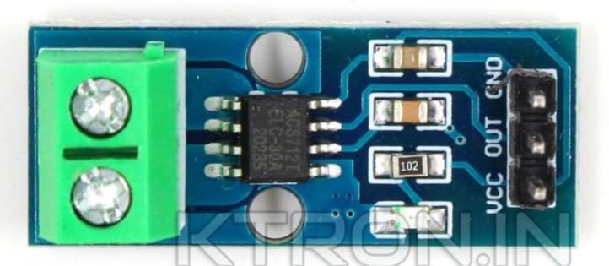
TECHNICAL APPROACH
FLUX
Technologies to be used
1)Software
2)Hardware
ESP32 or ESP8266
ACS712 (current sensor)
ZMPT101B (voltage sensor)
SRD-5VDC-SL-C (Relay)
Methodology and process for implementation

Slide 4
FEASIBILITY AND VIABILITY
FLUX
Feasibility of the idea
User-friendly Interface
Real-time access
Centralized Platform
Cost-effective
Strategies for overcoming these challenges
Use more robust and accurate sensors with built-in filtering and compensation.
Implement redundancy and fail-safe mechanisms to ensure continuous monitoring.
Develop advanced algorithms to predict faults with higher accuracy and fewer false alarms.
Provide a scalable architecture that can be easily deployed and managed across multiple sites.
Incorporate self-diagnostic features and remote maintenance capabilities to reduce overhead.
Potential challenges and risks
Potential for False Alarms
Lack of Robustness
Inaccurate measurements from faulty sensors
Scalability Issues
Maintenance Overhead

Slide 5
IMPACT AND BENEFITS
FLUX
Potential impact on the target audience Benefits of the solution
Reduced risk of electrical accidents: By detecting and alerting to potential hazards like earth leakage currents, the system helps prevent accidents and injuries
Reduced Power Outages: Improved earthing performance led to a substantial reduction in power surges and voltage fluctuations, minimizing equipment damage and downtime.
Minimized equipment replacement: Early detection of faults can prevent catastrophic failures that may damage valuable equipment and require costly equipment replacements.
Cost Savings: By preventing equipment failures and reducing downtime, the facility realized significant cost savings.
Compliance with Regulations: The system ensured compliance with industry standards and regulations related to earthing systems.

Slide 6
RESEARCH AND REFERENCES
FLUX
Research work
[1] R. K. Kodali and A. Sahu, “An IoT based weather information prototype using wemos,” in 2016 2nd
International Conference on Contemporary Computing and Informatics (IC3I). IEEE, 2016, pp. 612–616.
[2] Y. Yang, T. Lee, Y. Lee, J. Choi, E. Park, and H. Lim, “Implementation of infants risk detection sensing system
using IoT,” in AIP Conference Proceedings, vol. 1836, no. 1. AIP Publishing, 2017, p. 020073.
[3] A. K. S. Dwarka Prasad and H. Sharma, “Electric shock and human body,” International Journal of Electrical
and Power Engineering, vol. 4, no. 3, pp. 177–181, 2010.
[4] Sutanto, Erwin, et al. "IoT based electricity leakage current monitoring using Blynk app." AIP Conference Proceedings. Vol. 2314. No. 1. AIP Publishing, 2020.

